Slide 1
EDU-VET
EDU-VET Curriculum and Online Course Meeting 16th- 18th of March 2021
Project Number: 2019-1-DE02-KA202-006068
E-Learning, Digitisation and Units for Learning at VET schools – Creating online Learning Environments in Technical Education for European metal industry
What´s laying ahead of us? – Next steps
The European Commission support for the production of this publication does not constitute an endorsement of the contents which reflects the views only of the authors, and the Commission cannot be held responsible for any use which may be made of the information contained therein.

Slide 2
EDU-VET What´s laying ahead of us?
- Next steps
EDU-VET Curriculum and Online Course Meeting 16th- 18th of March 2021
Project Number: 2019-1-DE02-KA202-006068
The European Commission support for the production of this publication does not constitute an endorsement of the contents which reflects the views only of the authors, and the Commission cannot be held responsible for any use which may be made of the information contained therein.

Slide 3
Next steps – Summary
Please have a closer look into the workplan to get further details for next project activities and its deadlines!
IO1:
Translation of Summary Research Report
Creation of flipbook (IK)
IO2:
Development of EDU-VET Curriculum
IO3:
Creation of interactive tasks for online and classroom scenarios
Creation of introduction videos
IO4:
Writing book chapter
Creation of guideline concept for teachers
IO5:
Searching for best-practices/ metal companies

Slide 4
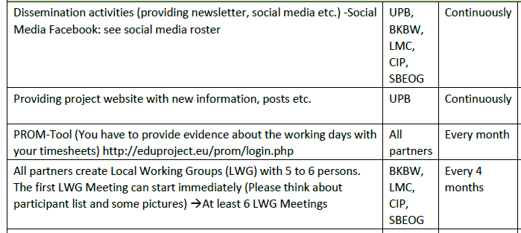
Next steps – Workplan
In general/ dissemination activities:
PROM Tool !!! Please create your Timesheets in PROM !!
Print out the timesheets, sign it, scan it and send it to Jana! → until end of March 2021
Dissemination activities

Slide 5
Next steps – Workplan
IO1:

Slide 6
Next steps – Workplan
IO2:

Slide 7
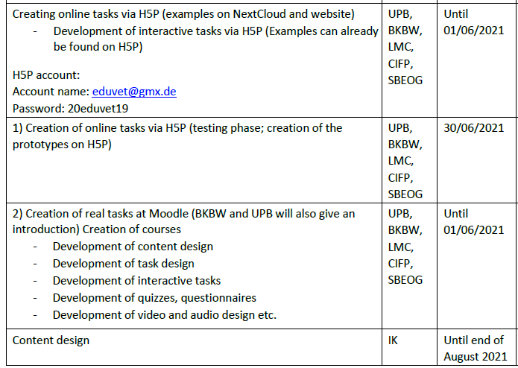
Next steps – Workplan
IO3:

Slide 8
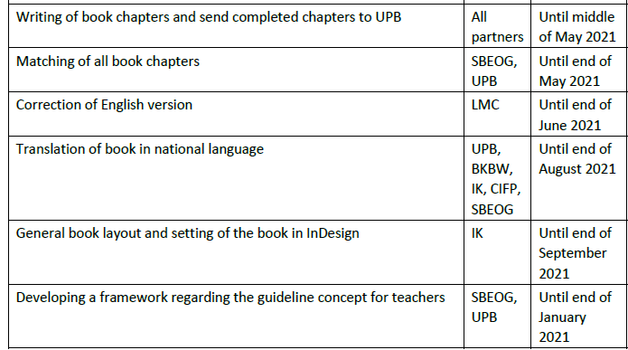
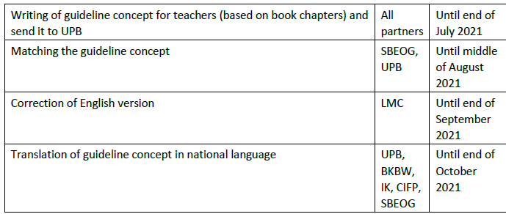
Next steps – Workplan
IO4:

Slide 9
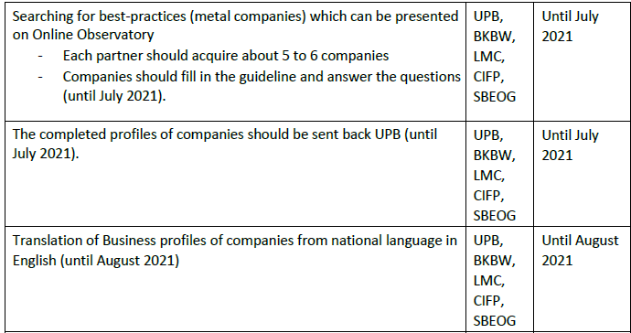
Next steps – Workplan
IO5:

Slide 10
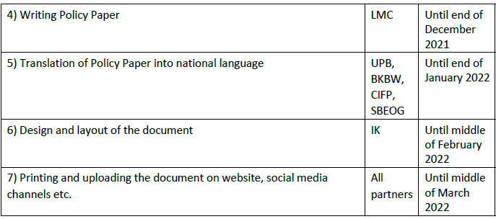
Next steps – Workplan
IO6:

Slide 11
Next steps – Multiplier Event
Multiplier Events

Slide 12
Do you have any questions?
Contact
Marc Beutner University Paderborn, Warburger Str. 100 33098 Paderborn, Germany Marc.Beutner@uni-paderborn.de
http://wiwi.uni-paderborn.de/department5/ wirtschaftspaedagogik-prof-beutner/
The European Commission support for the production of this publication does not constitute an endorsement of the contents which reflects the views only of the authors, and the Commission cannot be held responsible for any use which may be made of the information contained therein.

