Slide 1
EDU-VET
EDU-VET Curriculum and Online Course Meeting 16th- 18th of March 2021
Project Number: 2019-1-DE02-KA202-006068
Part 2
E-Learning, Digitisation and Units for Learning at VET schools – Creating online Learning Environments in Technical Education for European metal industry
Administration and financial information
The European Commission support for the production of this publication does not constitute an endorsement of the contents which reflects the views only of the authors, and the Commission cannot be held responsible for any use which may be made of the information contained therein.

Slide 2
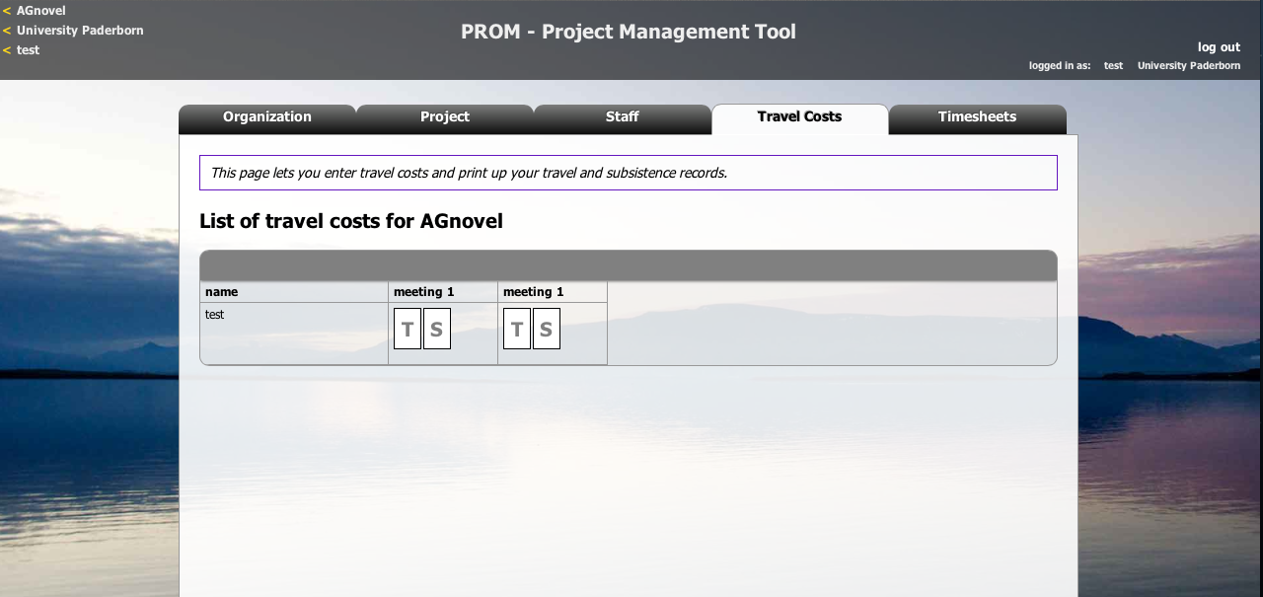
The PROM Tool
The PROM Tool – Travel costs (1)

Slide 3
The PROM Tool
The PROM Tool – Travel costs (2) – Travel record I

Slide 4
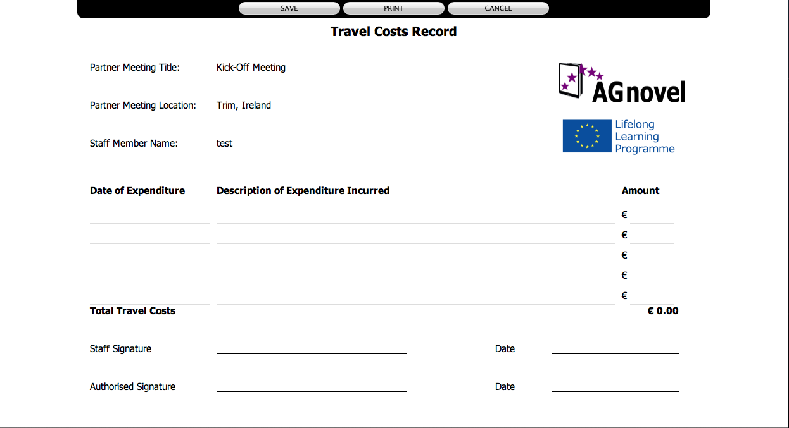
The PROM Tool
The PROM Tool – Travel costs (3) – Travel record II

Slide 5
The PROM Tool
The PROM Tool – Travel costs (4) – Subsistence costs I

Slide 6
The PROM Tool
The PROM Tool – Travel costs (5) – Subsistence costs II

Slide 7
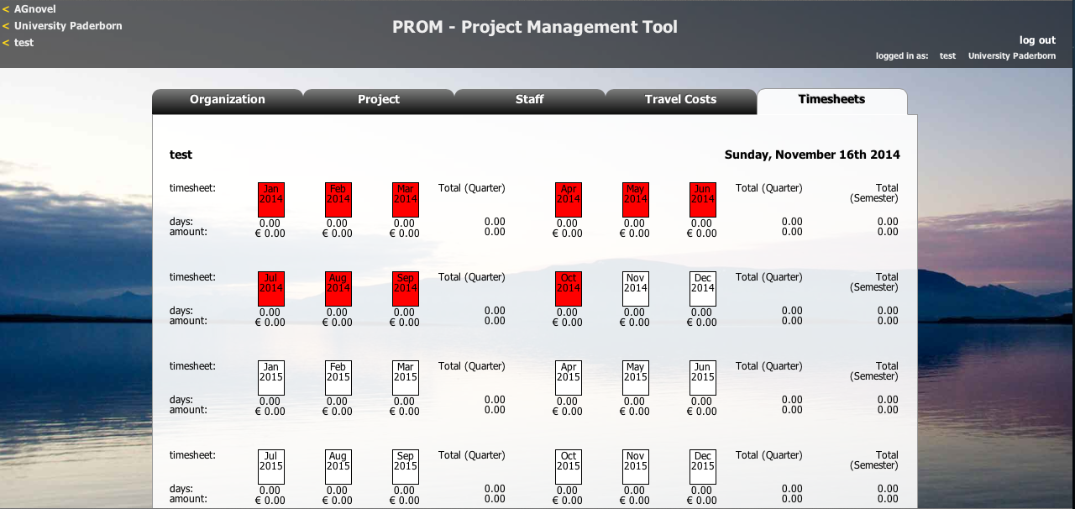
The PROM Tool
The PROM Tool – Timesheets (1) – Select the month

Slide 8
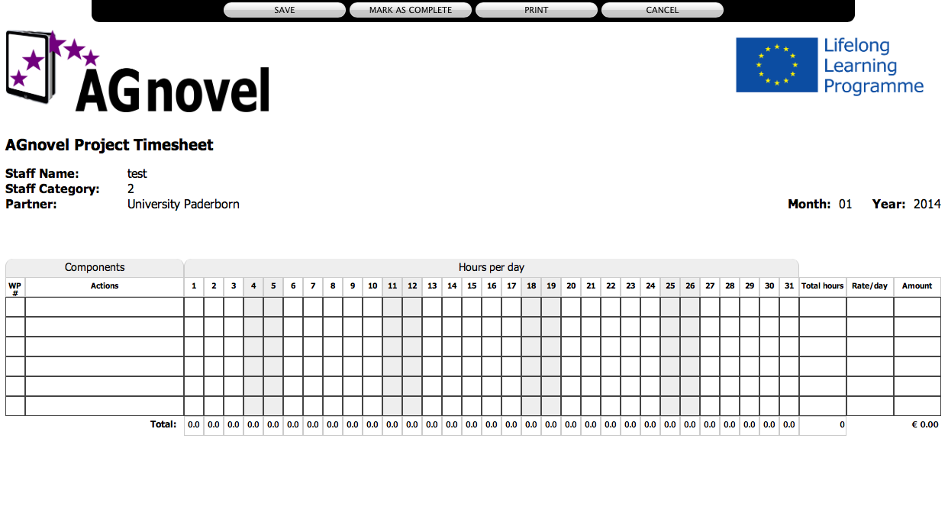
The PROM Tool
The PROM Tool – Timesheets (2) – Fill in the form I

Slide 9
The PROM Tool
The PROM Tool – Timesheets (3) – Fill in the form II

Slide 10
The PROM Tool
The PROM Tool – Timesheets (4) - Overview

Slide 11
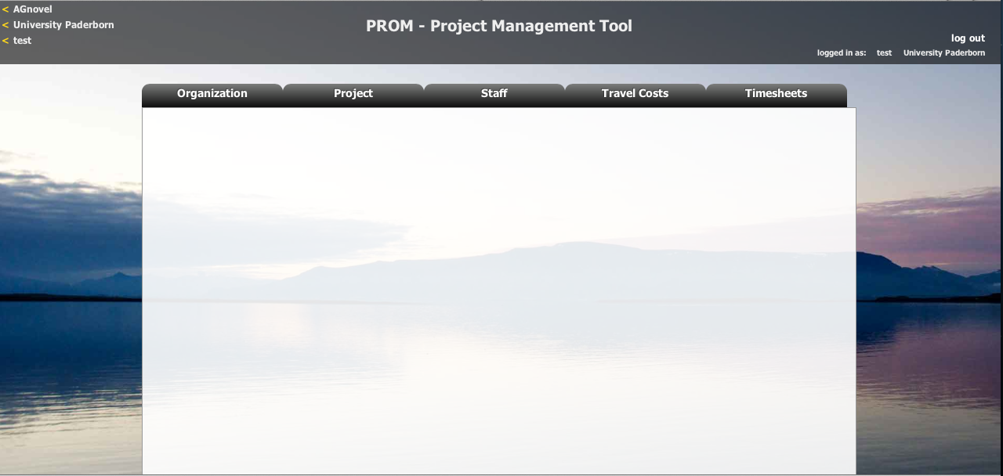
The PROM Tool
The PROM Tool – Log out

Slide 12
The PROM Tool
Overview – Task descriptions for PROM
Intellectual Output | Task description | Who?
IO1 | Developing Research Framework | UPB
 | Conducting desk-based research | All partners
 | Conducting field-based research | All partners
 | Collating research reports | UPB
 | Writing Summary Research Report | UPB
 | Translation of Summary Research Report | All partners
 | Drafting a Research Report | IK
 | Design and layout of the Summary Report | IK
IO2 | Developing curricular framework | UPB
 | Discussing curricular structure | UPB, LMC, BKBW, CIFP, SBEOG
 | Matching curriculum with syllabi | UPB, LMC, BKBW, CIFP, SBEOG
 | Writing of a report on discussion results | UPB, LMC, BKBW, CIFP, SBEOG
 | Writing of curriculum | UPB, LMC, BKBW, CIFP, SBEOG
 | Checking of curriculum | UPB, LMC, BKBW, CIFP, SBEOG
 | Providing a technical online basis for curriculum | IK
 | Integration of the tool in the database structure of the EDU-VET-Website | IK
 | Writing a publication on the curriculum | UPB, BKBW
 | Creating a paper brochure | UPB, BKBW
IO3 | Developing content/ tasks | UPB, LMC, BKBW, CIFP, SBEOG
 | Providing of database for online courses | IK
 | Programming the online courses | IK
 | Creating content design | IK
Intellectual Output | Task description | Who?
IO4 | Creating a book structure | All partners
 | Discussing book structure | SBEOG
 | Moderating discussion process of book structure | SBEOG
 | Writing book content | All partners
 | Creating graphics or illustrations for book | All partners
 | Proof reading of book contents | All partners
 | Organising book print | IK
IO5 | Creating criteria guideline | UPB, CIFP
 | Creating a criteria setting | UPB, CIFP
 | Collecting ideas for criteria guideline | CIFP
 | Collecting showcases | UPB, LMC, BKBW, CIFP, SBEOG
 | Supporting design work | IK
 | Creating first prototype of online environment | IK
 | Developing an online environment | IK
 | Integrating an online environment | IK
 | Testing an online environment | IK
 | Final checking of business profiles | UPB
IO6 | Drafting Policy Paper | LMC
 | Developing of Policy Paper questionnaire | LMC
 | Completing Policy Paper questionnaire | All partners
 | Completing Policy Paper | All partners
 | Translating Policy Paper | UPB, LMC, BKBW, CIFP, SBEOG
 | Designing Policy Paper | IK
 | Layout Policy Paper in all partner languages | IK
This overview is also uploaded on NextCloud!

Slide 13
Contact
Marc Beutner University Paderborn, Warburger Str. 100 33098 Paderborn, Germany Marc.Beutner@uni-paderborn.de
http://wiwi.uni-paderborn.de/department5/ wirtschaftspaedagogik-prof-beutner/
The European Commission support for the production of this publication does not constitute an endorsement of the contents which reflects the views only of the authors, and the Commission cannot be held responsible for any use which may be made of the information contained therein.

