Slide 1
EDU-VET
EDU-VET Curriculum and Online Course Meeting 16th- 18th of March 2021
Project Number: 2019-1-DE02-KA202-006068
Part 1
E-Learning, Digitisation and Units for Learning at VET schools – Creating online Learning Environments in Technical Education for European metal industry
Administration and financial information
The European Commission support for the production of this publication does not constitute an endorsement of the contents which reflects the views only of the authors, and the Commission cannot be held responsible for any use which may be made of the information contained therein.

Slide 2
EDU-VET Administrative and financial information
EDU-VET Curriculum and Online Course Meeting 16th- 18th of March 2021
Project Number: 2019-1-DE02-KA202-006068
The European Commission support for the production of this publication does not constitute an endorsement of the contents which reflects the views only of the authors, and the Commission cannot be held responsible for any use which may be made of the information contained therein.

Slide 3
Financial Reporting
Please…
provide all financial and supporting documents every 4 months (first year) and every 3 months (second year).
use the PROM-TOOL to create your financial documentation.
stick on the working days per Intellectual Output and staff category.
create one timesheet per month.
ensure that you only report one staff category per month.
don`t report Saturdays, Sundays, holidays and sick days.
sign timesheets for every month.
send all documents of a reporting period in one package via e-mail and the originals via post.

Slide 4
The PROM Tool
The Login Area - http://eduproject.eu/prom/login.php

Slide 5
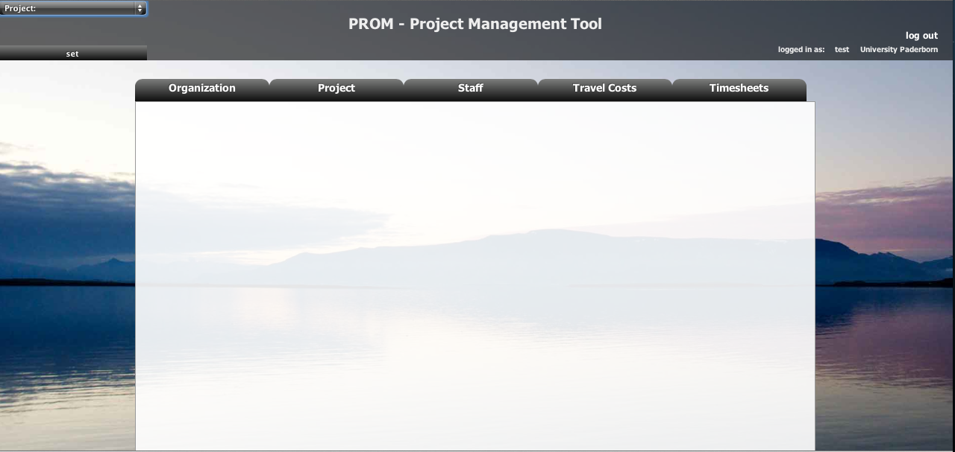
The PROM Tool
The PROM Start Page (1)

Slide 6
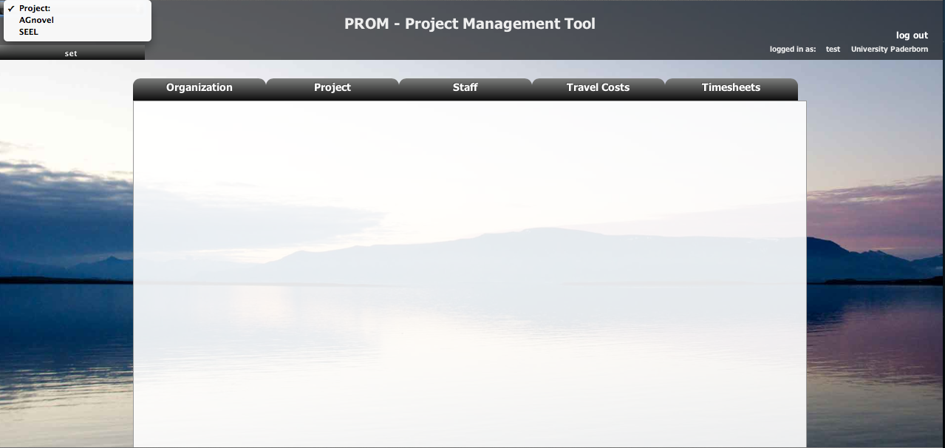
The PROM Tool
The PROM Start Page (2) – Set the project

Slide 7
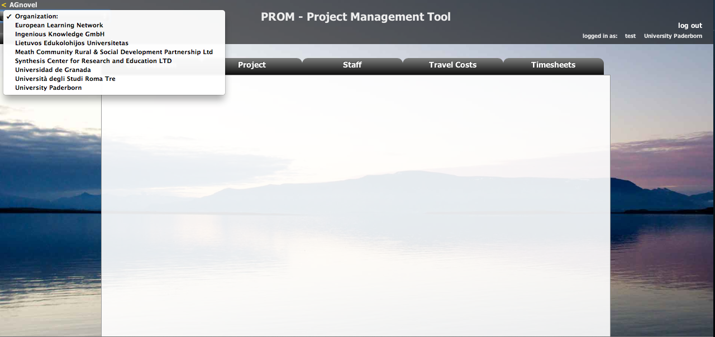
The PROM Tool
The PROM Start Page (3) – Set the organization

Slide 8
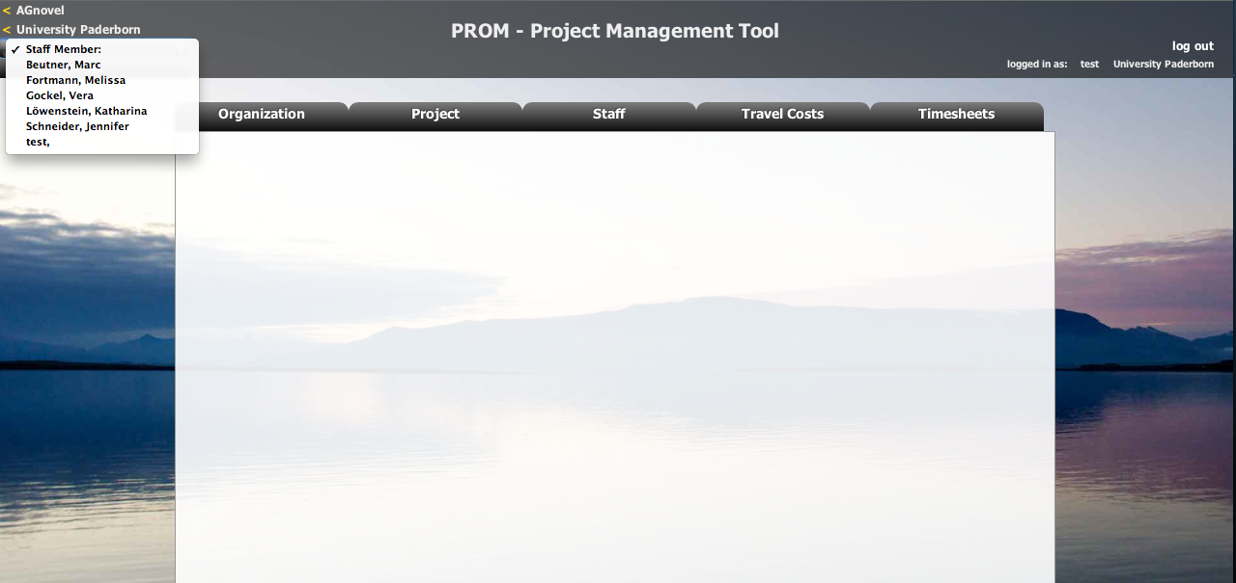
The PROM Tool
The PROM Start Page (4) – Set the staff member

Slide 9
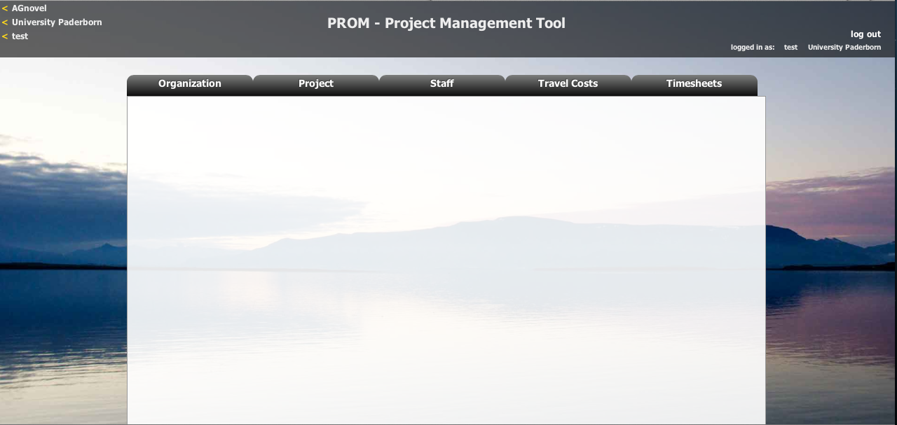
The PROM Tool
The PROM Start Page (5) – Start

Slide 10
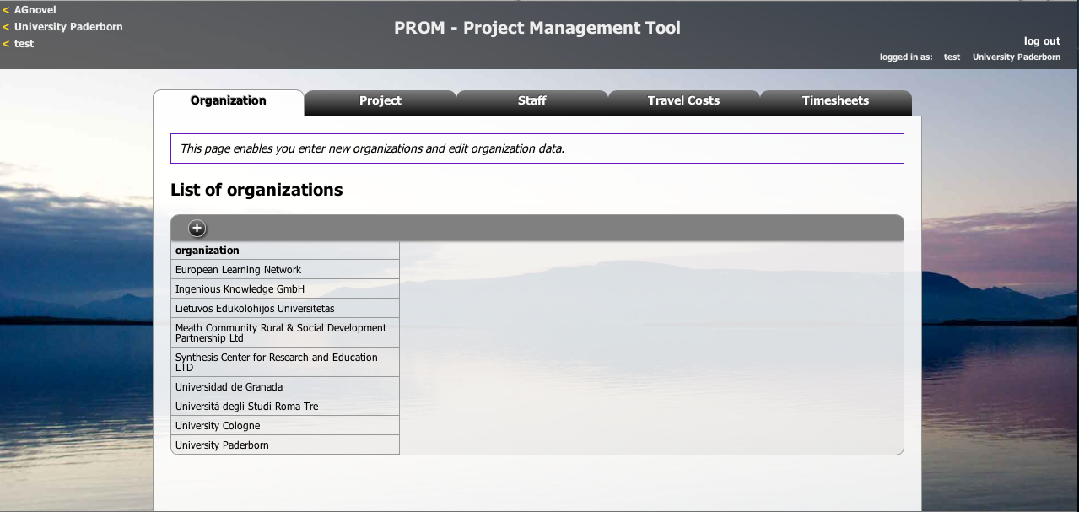
The PROM Tool
The PROM Tool – List of organizations

Slide 11
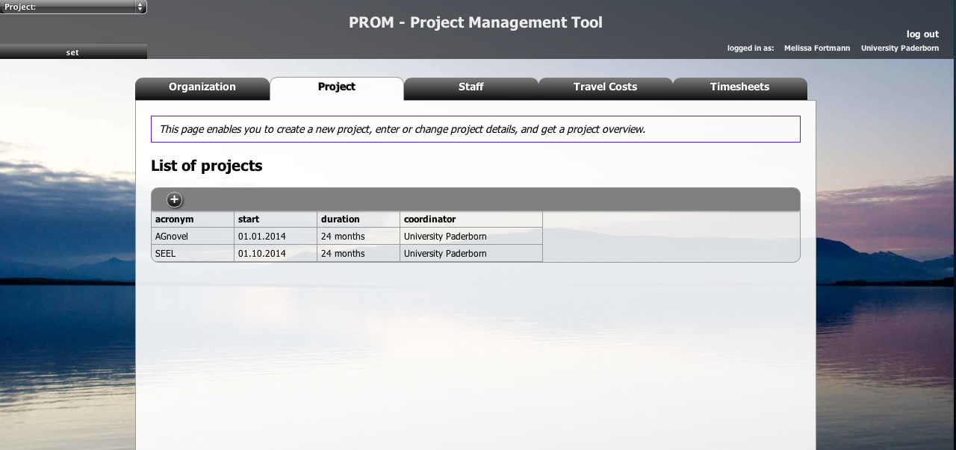
The PROM Tool
The PROM Tool – List of projects

Slide 12
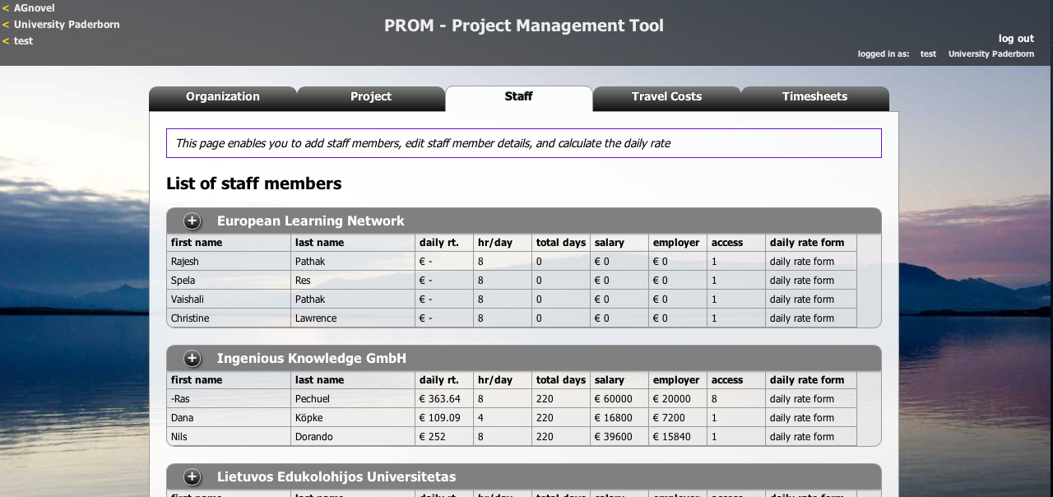
The PROM Tool
The PROM Tool – List of staff members

