Slide 1
EDU-VET
EDU-VET Curriculum and Online Course Meeting 16th- 18th of March 2021
Project Number: 2019-1-DE02-KA202-006068
E-Learning, Digitisation and Units for Learning at VET schools – Creating online Learning Environments in Technical Education for European metal industry
Dissemination and exploitation
The European Commission support for the production of this publication does not constitute an endorsement of the contents which reflects the views only of the authors, and the Commission cannot be held responsible for any use which may be made of the information contained therein.

Slide 2
EDU-VET Dissemination and exploitation
EDU-VET Curriculum and Online Course Meeting 16th- 18th of March 2021
Project Number: 2019-1-DE02-KA202-006068
The European Commission support for the production of this publication does not constitute an endorsement of the contents which reflects the views only of the authors, and the Commission cannot be held responsible for any use which may be made of the information contained therein.

Slide 3
Dissemination activities
Dissemination activities should be done regularly by each partner during the project
Posts on Facebook, posts on school website etc.
Printed materials: Flyer, Posters, Brochures, Newsletters etc.
Articles about project in local newspapers or online article etc.
Face-to-Face/ Online meetings with students, parents, teachers or interested people etc.
Please use the Dissemination table for documentation
Please see social media roster (Facebook)

Slide 4
Dissemination activities – Next steps
All partners create Local Working Groups (LWG) with 5 to 6 persons. The first LWG Meeting can start immediately (Please think about participant list and some pictures) →At least 6 LWG Meetings (Online Meetings are also possible) | BKBW, LMC, CIP, SBEOG | Every 4 months
Social Media Facebook: see social media roster | UPB, BKBW, LMC, CIP, SBEOG | Every month
EDU-VET Website | UPB | Every month (3-5 posts in a month)

Slide 5
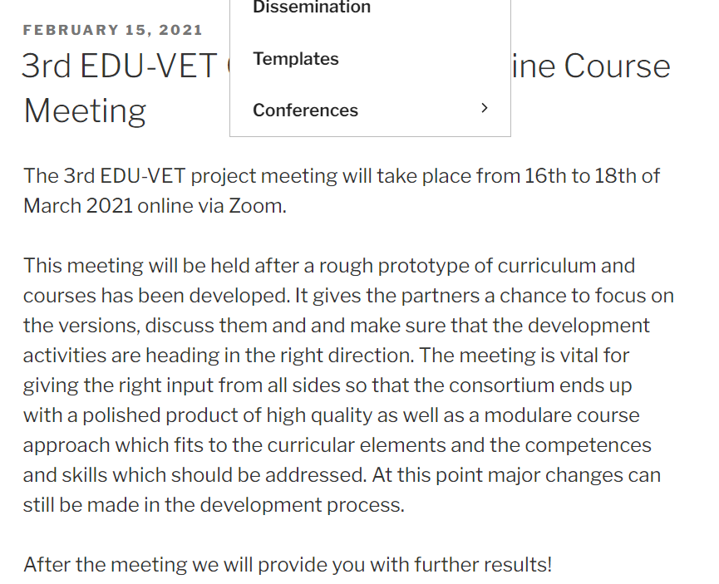
Dissemination activities
EDU-VET – Website
https://eduproject.eu/eduvet/index.php/en/

Slide 6
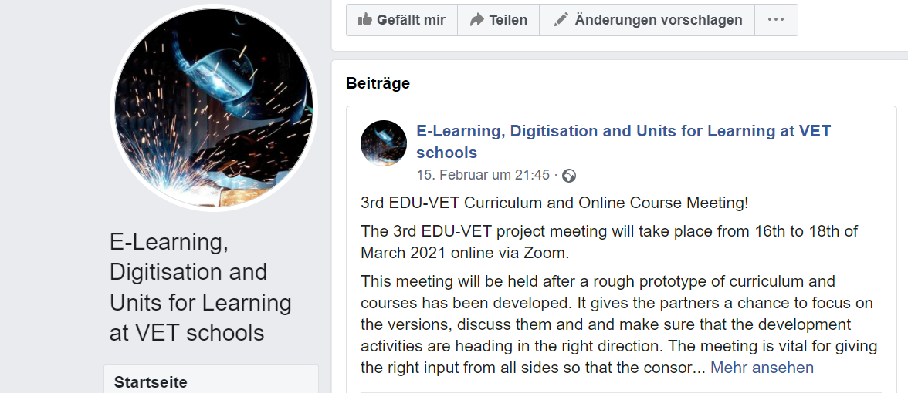
Dissemination activities
EDU-VET – Facebook (see social media roaster)
https://www.facebook.com/E-Learning-Digitisation-and-Units-for-Learning-at-VET-schools-103092851154106/?modal=admin_todo_tour

Slide 7
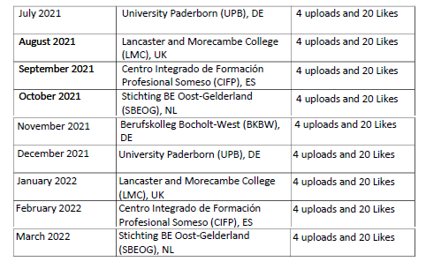
Dissemination activities
EDU-VET –social media roster for Facebook – UPDATE!!

Slide 8
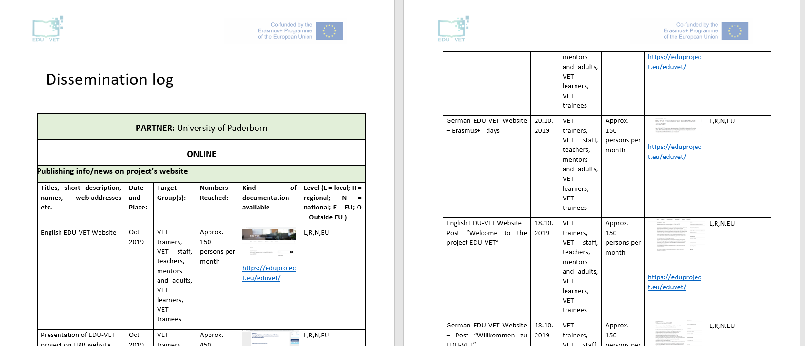
Dissemination activities
Dissemination Table

Slide 9
Do you have any questions?
Contact
Marc Beutner University Paderborn, Warburger Str. 100 33098 Paderborn, Germany Marc.Beutner@uni-paderborn.de
http://wiwi.uni-paderborn.de/department5/ wirtschaftspaedagogik-prof-beutner/
The European Commission support for the production of this publication does not constitute an endorsement of the contents which reflects the views only of the authors, and the Commission cannot be held responsible for any use which may be made of the information contained therein.

