Slide 1
EDU-VET
EDU-VET Curriculum and Online Course Meeting 16th- 18th of March 2021
Project Number: 2019-1-DE02-KA202-006068
E-Learning, Digitisation and Units for Learning at VET schools – Creating online Learning Environments in Technical Education for European metal industry
IO5: Online Observatory
The European Commission support for the production of this publication does not constitute an endorsement of the contents which reflects the views only of the authors, and the Commission cannot be held responsible for any use which may be made of the information contained therein.

Slide 2
EDU-VET IO5: Online Observatory
EDU-VET – Curriculum and Online Course Meeting Online Project Meeting 16th to 18th of March 2021
Project Number: 2019-1-DE02-KA202-006068
The European Commission support for the production of this publication does not constitute an endorsement of the contents which reflects the views only of the authors, and the Commission cannot be held responsible for any use which may be made of the information contained therein.

Slide 3
Current status of IO5
IO5: Online Observatory
Leading organisation: CIFP
Duration: 01/01/2020 to 30/09/2021
Creation of criteria setting for Online Observatory: Done ✓
Provide guidelines to partner: Done ✓
Translation of Business Profile in own language: Done ✓
Technical implementation and development of technical infrastructure of Online Observatory: In progress (IK, until middle of December 2020)
Searching for best-practices (metal companies) which can be presented on Online Observatory: In progress (all partners, until May 2021)
Each partner should acquire about 5 to 6 companies
Companies should fill in the guideline and answer the questions
The completed profiles of companies should be sent back UPB
Translation of company profiles in English

Slide 4
Main issues about the searching
IO5: Online Observatory
Leading organisation: CIFP
Duration: 01/01/2020 to 30/09/2021
Business profile must be filled out during a face-to-face interview (if possible) with some representative belonging to the best-practice company (2 pages at most, 250 words approx. per page)
2 pictures that illustrate the main activities of this best-practice company
1 video that makes a presentation of this best-practice company (2 options):
Using a video provided by the company
Record a new one on-site
Getting an official acceptance (email) where this best-practice company allows us to publish its data within the EDU-VET Online Observatory
Inform this best-practice company there will be a forum on the EDU-VET Online Observatory to exchange impressions among users and them; therefore it would be desiderable they accept it and ask the questions posted on it.

Slide 5
IO5 deadlines
IO5: Online Observatory
Leading organisation: CIFP
Duration: 01/01/2020 to 30/09/2021
(VET schools)
1st best-practice company submitted to CIFP and UPB before january, the 15th
Business profile
Photos + video
Official acceptance
2nd and 3rd ones submitted before february, the 26th
Rest of examples submitted before may, the 28th
(IK)
Implementation on EDU-VET Online Observatory, at most, 6 weeks after the submission

Slide 6
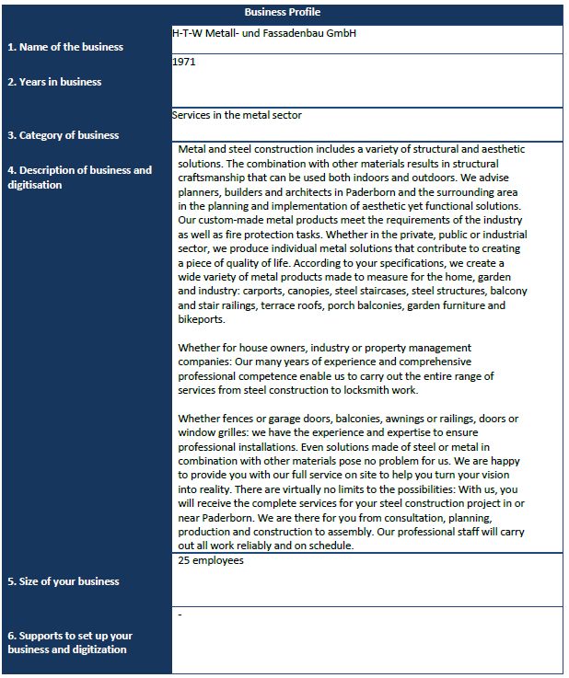
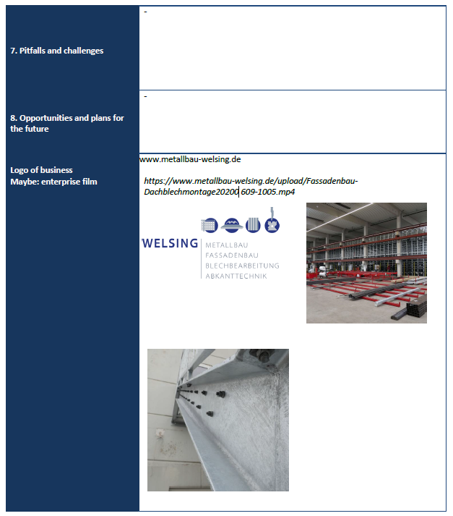
Presentation of Best-Practices - Example of a business profile from Germany

Slide 7
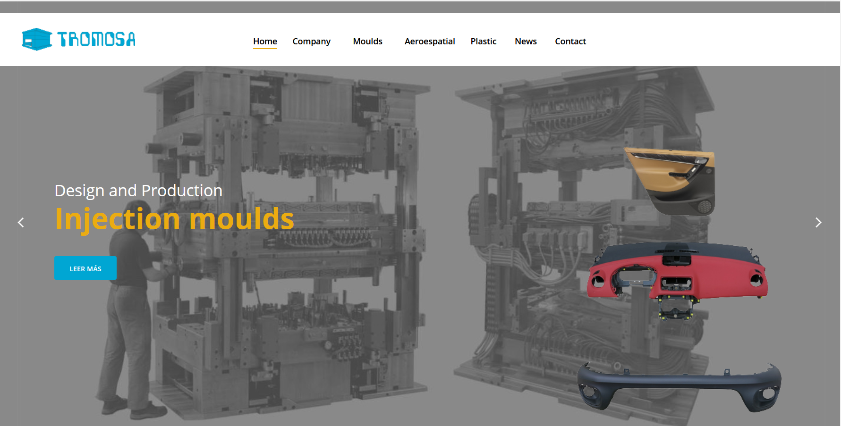
Presentation of Best-Practices - Example of a best-practice company from Spain

Slide 8
Do you have any questions?
Contact
Marc Beutner University Paderborn, Warburger Str. 100 33098 Paderborn, Germany Marc.Beutner@uni-paderborn.de
http://wiwi.uni-paderborn.de/department5/ wirtschaftspaedagogik-prof-beutner/
The European Commission support for the production of this publication does not constitute an endorsement of the contents which reflects the views only of the authors, and the Commission cannot be held responsible for any use which may be made of the information contained therein.

