Slide 1
EDU-VET
EDU-VET Curriculum and Online Course Meeting 16th- 18th of March 2021
Project Number: 2019-1-DE02-KA202-006068
E-Learning, Digitisation and Units for Learning at VET schools – Creating online Learning Environments in Technical Education for European metal industry
IO3: Development of task for EDU-VET courses – University of Paderborn
The European Commission support for the production of this publication does not constitute an endorsement of the contents which reflects the views only of the authors, and the Commission cannot be held responsible for any use which may be made of the information contained therein.

Slide 2
IO3: Development of task for EDU-VET courses – University of Paderborn
EDU-VET – Curriculum and Online Course Meeting Online Project Meeting 16th to 18th of March 2021
Project Number: 2019-1-DE02-KA202-006068
The European Commission support for the production of this publication does not constitute an endorsement of the contents which reflects the views only of the authors, and the Commission cannot be held responsible for any use which may be made of the information contained therein.

Slide 3
Development of interactive tasks
Development of H5P tasks for the online scenario:
The interactive tasks are to be created via H5P (Word Press)
Firstly, all partners develop the tasks in English
Translations into the national language will be started middle of the year 2021(more information will follow)
Each partner should create at least 20 tasks
The topics of the tasks should be related to the learning modules
H5P offers about 50 task types - you can choose any suitable task type!
Instructions for the different task types and the creation of it can be found in the document “O2-P1-EDU-VET-Overview tasks H5P-EN”

Slide 4
Development of interactive tasks
Development of H5P tasks for the online scenario:
Please label the tasks as follows:
EDU-VET-EN-Milling 1-Feed speed-Drag the words-Entry level
Language
Concrete content/
topic
Project
Manufacturing method (learning module)
Task type in H5P
Difficulty level
Task numbering

Slide 5
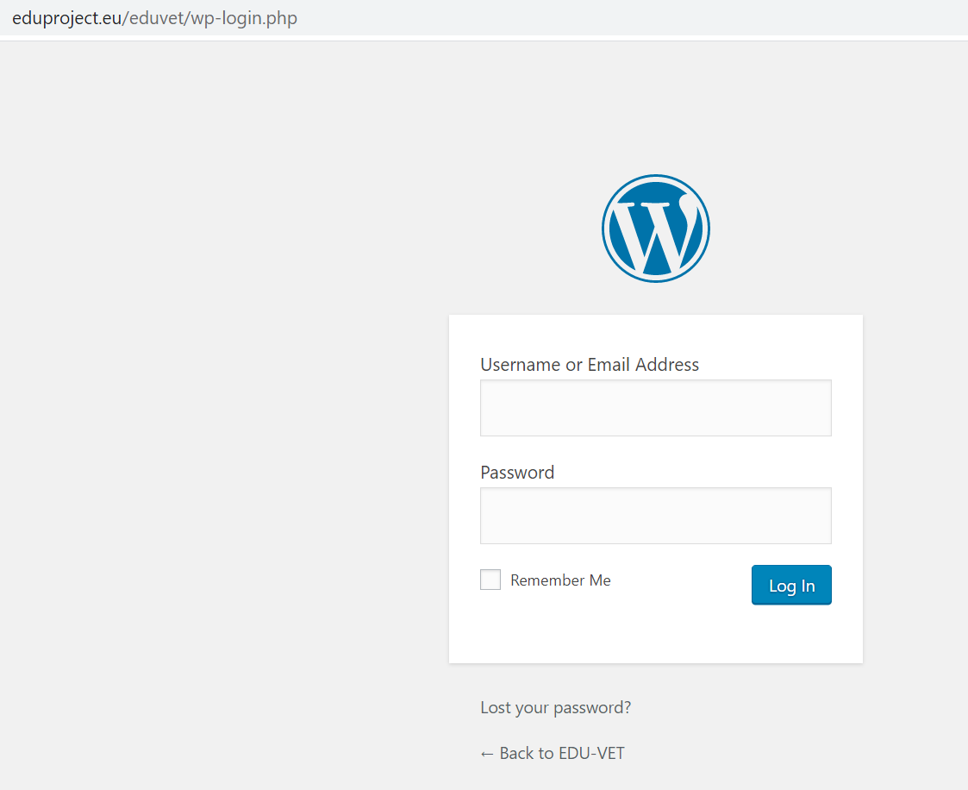
Development of interactive tasks
Development of H5P tasks for the online scenario (via Word Press):
https://eduproject.eu/eduvet/wp-login.php

Slide 6
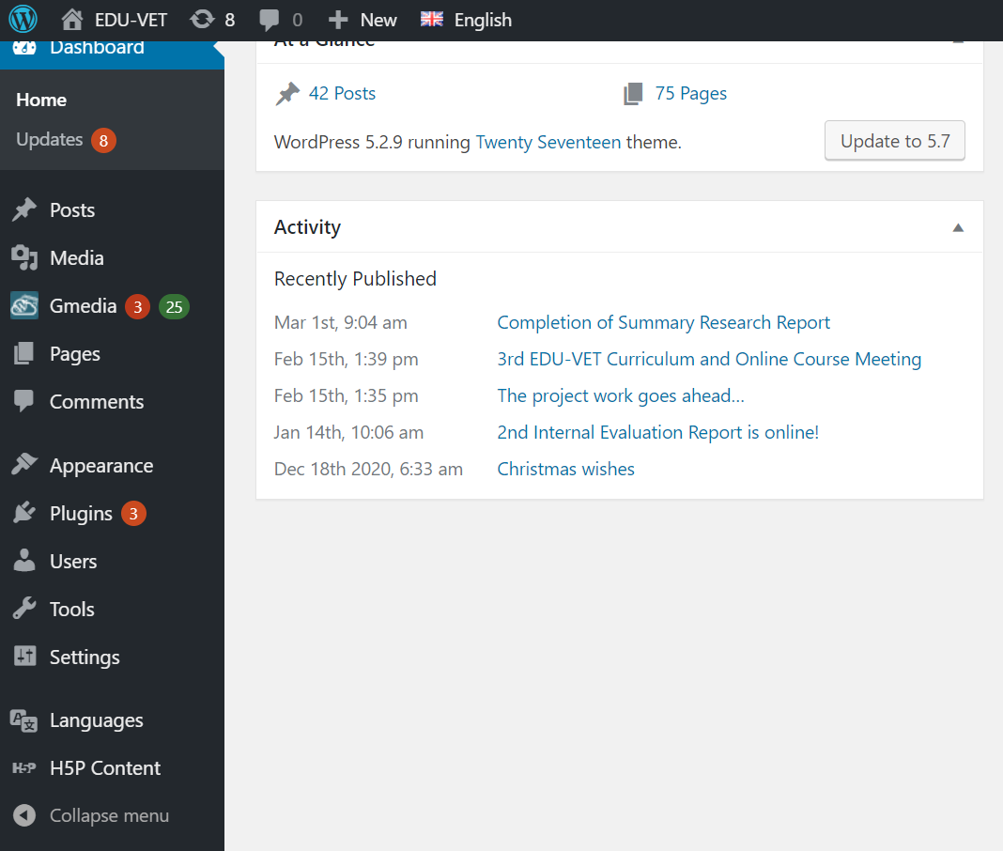
Development of interactive tasks
Let´s have a closer look!

Slide 7
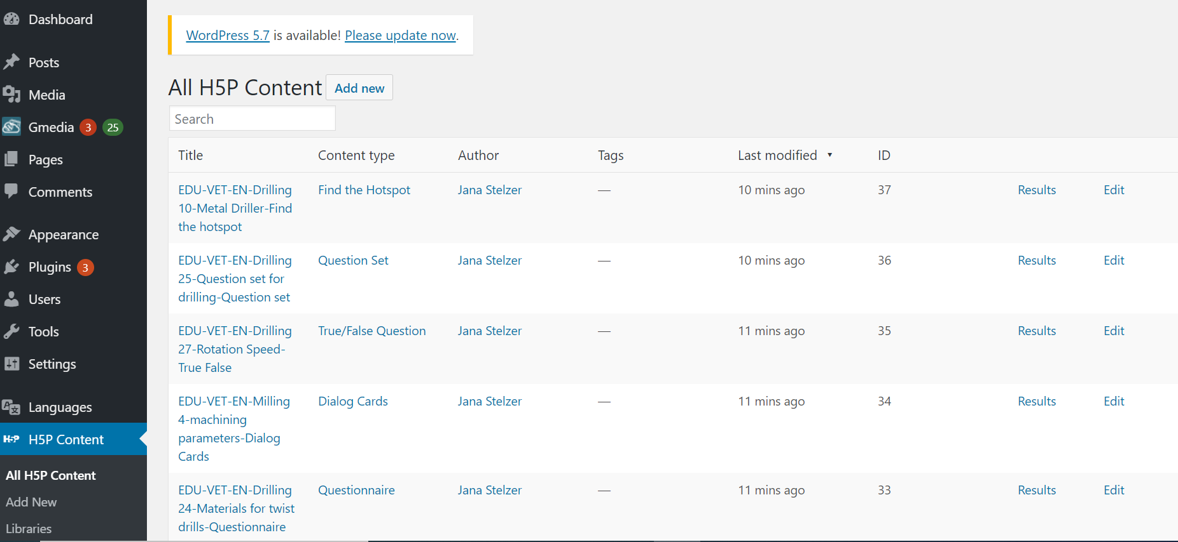
Development of interactive tasks

Slide 8
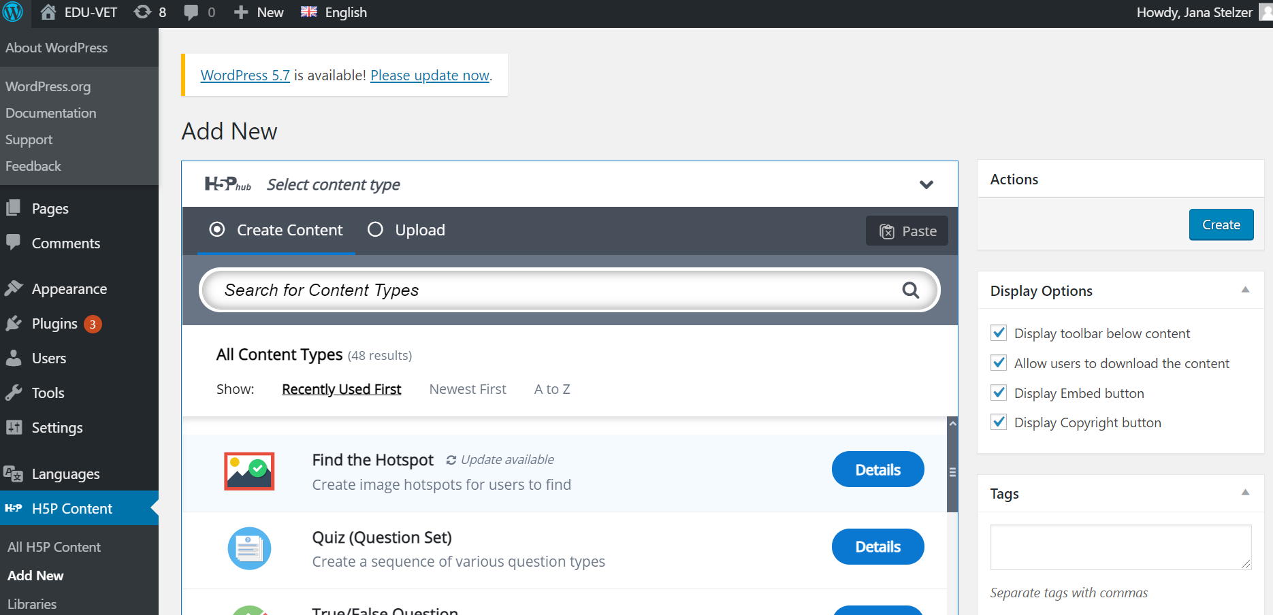
Development of interactive tasks

Slide 9
Do you have any questions?
Contact
Marc Beutner University Paderborn, Warburger Str. 100 33098 Paderborn, Germany Marc.Beutner@uni-paderborn.de
http://wiwi.uni-paderborn.de/department5/ wirtschaftspaedagogik-prof-beutner/
The European Commission support for the production of this publication does not constitute an endorsement of the contents which reflects the views only of the authors, and the Commission cannot be held responsible for any use which may be made of the information contained therein.

