Slide 1
EDU-VET
EDU-VET Curriculum and Online Course Meeting 16th- 18th of March 2021
Project Number: 2019-1-DE02-KA202-006068
E-Learning, Digitisation and Units for Learning at VET schools – Creating online Learning Environments in Technical Education for European metal industry
IO2: EDU-VET Curriculum
The European Commission support for the production of this publication does not constitute an endorsement of the contents which reflects the views only of the authors, and the Commission cannot be held responsible for any use which may be made of the information contained therein.

Slide 2
EDU-VET IO2: EDU-VET Curriculum
EDU-VET Curriculum and Online Course Meeting 16th- 18th of March 2021
Project Number: 2019-1-DE02-KA202-006068
The European Commission support for the production of this publication does not constitute an endorsement of the contents which reflects the views only of the authors, and the Commission cannot be held responsible for any use which may be made of the information contained therein.

Slide 3
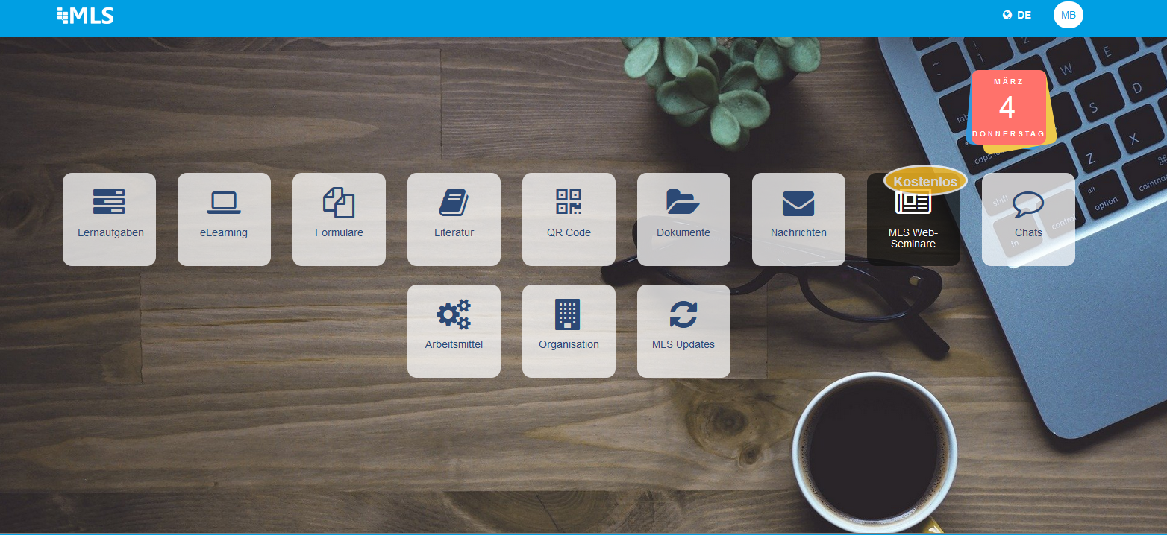
Another Learning Platform in the metal field
https://mls.mobil-lernen.com/de/login

Slide 4
The EDU-VET Moodle platform
http://edu-vet.eduproject.eu/

Slide 5
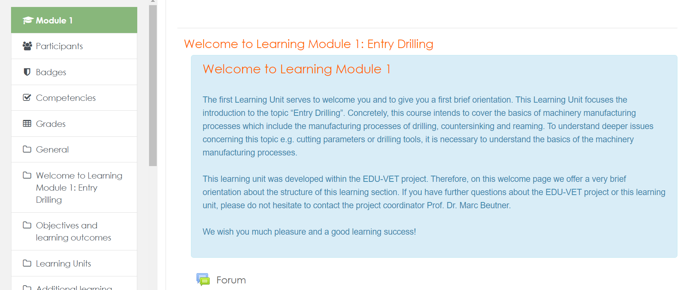
The EDU-VET Moodle platform

Slide 6
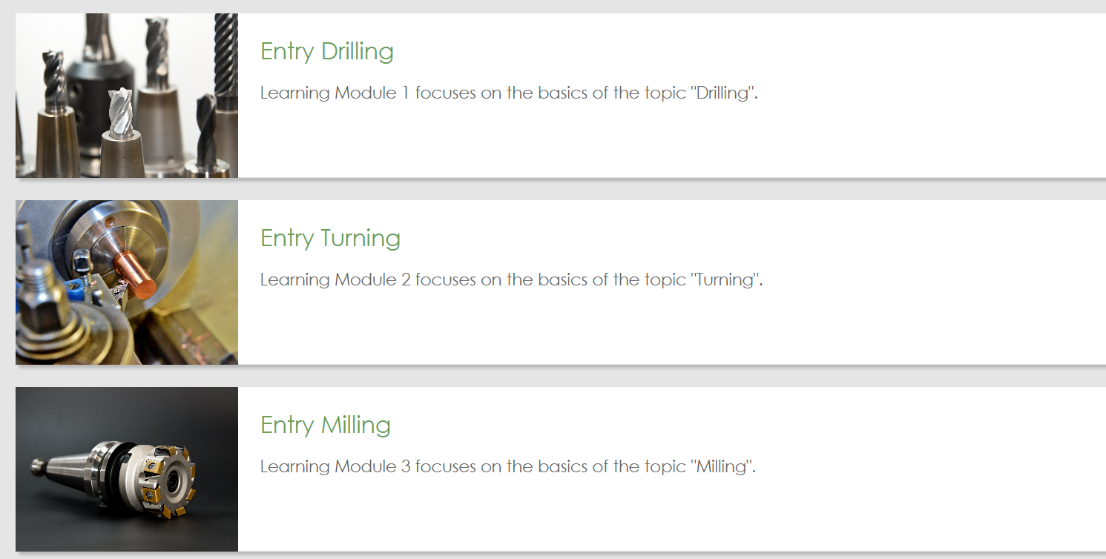
The EDU-VET Moodle platform

Slide 7
The EDU-VET Moodle platform
Creation of Moodle demo course by IK
→ Let´s have closer look into the Moodle system!!
http://edu-vet.eduproject.eu/
Do you have further ideas for implementation of the
EDU-VET Moodle Learning System??

Slide 8
The EDU-VET curriculum aims to support many different users in different European countries – this shall be made possible by integrating the specifically different viewpoints of the four EDU-VET partner schools.
The following design principles should help to meet this objective
The curriculum is primarily structured by the process steps of the „EDU-VET manufacturing process model“ in the fomat of an event process chain. Thus there is a first trans-national and trans-school-system applicable integration means(see slide 3).
Secondarily the curriculum is structured by the skill levels of the „EDU-VET curriculum skill level model“. This allows the assignment of the learning units to different student groups according their state of development (see slide 4).
Thirdly the EDU-VET curriculum and learning units shall be easily integrated with the user‘s local curriculum and learning units, therefore the „EDU-VET curriculum learning unit model“ distinguishes different learning unit types and learning unit variants (see slide 5).
Finally, the learning units of the EDU-VET curriculum are classifed regarding delivery media and learning activity type in order to support the users in the process of delivery preparation and student orientation (see slide 6).

Slide 9
The EDU-VET process model describes a manufacturing process. An event initiates the execution of a process step. The execution of the process steps leads to the events of step is completed and step outcomes are ready.
Phase I: executed in class-/PC-room or (home-) office
Phase II: executed in workshop of school or „Ausbildungsbetrieb“ in Germany
Phase III: executed in class-/PC-room or (home-) office
a: Order „xy“ & supporting materials
a, b, c, d, e, f, g
C: Analyse M. order and supporting materials
E: Manufacture component xy
A: Analyse order and supporting materials
G: Evaluate office based preparations
d: ‚Plan‘ of workshop
f: Manuf. protocol & workpiece
b: ‚Plan‘ of further office preparations
h: Evaluation protocol part 1
D: Prepare workshop „WS-1“ for production
F: Final quality testing
H: Evaluate shopfloor based production
B: Plan production in workshop „WS-1“
c: Manuf. Order xy & supporting materials
e: Prepared workshop „WS-1“
g: Test protocols & tested workpieces
i: Evaluation proto-col part 2

Slide 10
The EDU-VET curriculum skill level model comprises three different skill levels distinguished by the complexity level to be handled on each skill level. Four sources drive the complexity.
Skill Level
Complexitiy Level
Complexitiy drivers
Entry
Level
Low
Complexitiy
Workpiece properties (esp. form of raw part and finished part, Machining properties of the workpiece material)
Manufacturing environment (qualities and conditions particularly of avalilable machines, tools, devices, auxilliaries)
Production process and process steps (number and complexity of production methods / steps / equipments needed respectively planned to create the different workpiece properties)
Task context and background (all needed knowledge and information available, all needed resources avaliable – several bits of knowledge and/or information and/or needed resources not available – methods and sources to close those gaps known or unknown resp. available or not available )
Advanced
Level
Medium
Complexitiy
Experienced
Level
High
Complexitiy

Slide 11
The EDU-VET curriculum learning unit model comprises learning units of different types and variants and shall support several different learning unit application types and variants, too.
Learning unit types and variants
[Type: e-L] electronic-Learning unit
[Var: EVb] EDU-VET built
[Var: H-m] Home-made
[Var: Sbs] Supplied by supplier A, B, C …
[Type: e-E ] electronic-Exercise unit
[Type: c-L] conventional-Learning unit
[Type: c-E ] conventional-Exercise unit
This structure should enable users to combine EDU-VET learning units with different "local" learning units according to their specific circumstances
Learning unit application types and variants
[Type: ILA] Insrtuctor-lead Learning unit Application
[Var: pcr] physical classroom
[Var: vcr] virtual classroom
[Var: PCr] physical PC-room
[Var: pWs] (physical) Workshop
[Type: SLA] Self-directed Learning unit Application
[Var: soi] self-organising individuals
[Var: sog] self-organising groups
[Var: smg] (self-)moderating groups
This structure should enable users to apply the EDU-VET learning units in different ways according to their specific circumstances

Slide 12
The EDU-VET curriculum learning units are classified regarding delivery media and regarding learning activity type, this creates four basic types: [e-L], [e-E], [c-L], and [c-E].
With regard to delivery media the units are classified either „e“or „c“
The attribution „e-“ or „electronic“ marks a learning unit as beeing delivered digitally. Digital terminals like PCs, notebooks, tablets, smartphones are therefore required to access and use this learning unit.
The attribution „c-“ or „conventional“ marks a learning unit as beeing delivered conventially. No digital terminals are required to access the learning unit. The learning materials are available in the form of digital print templates and/or paper-based copy templates.
With regard to delivery media the units are classified either „L“or „E“
The attribution „L“ or „Learning“ marks a unit as beeing dedicated to help the user create a consistent mental model of all the relevant entities and relationships in the subject area called terms and concepts.
The attribution „E“ or „Exercise“ marks a unit as beeing dedicated to help the user build comprehensive capabilities in the execution of prticular tasks or activities, the build-up of a mental model of the relevant methods and tools and experiences in the application of these methods and tools are supported.

Slide 13
Development of Curriculum – Module structure
Experienced Drilling / Turning / Milling 1
Experienced Drilling / Turning / Milling 2
Experienced Drilling / Turning / Milling 3
Advanced Drilling / Turning
Advanced Drilling / Milling
Advanced Turning / Milling
increasing complexity
Entry Drilling
UK
Entry Turning
ES
Entry Milling
NL
Pilar 1
Pilar 2
Pilar 3

Slide 14
Development of Curriculum
Structure and contents of Curriculum:
Curriculum Report as basis for the EDU-VET Curriculum
In summary, the curriculum will be structured with three fundamental pillars:
Pillar 1)
EDU-VET Process model
Pillar 2)
EDU-VET Curriculum skill level model
Pillar 3)
EDU-VET Curriculum learning unit model

Slide 15
NEEDS!
Creation of the modules
Description of target group and overview on the module topics
Integrate not only tasks but also explanation texts!

Slide 16
Do you have any questions?
Contact
Marc Beutner University Paderborn, Warburger Str. 100 33098 Paderborn, Germany Marc.Beutner@uni-paderborn.de
http://wiwi.uni-paderborn.de/department5/ wirtschaftspaedagogik-prof-beutner/
The European Commission support for the production of this publication does not constitute an endorsement of the contents which reflects the views only of the authors, and the Commission cannot be held responsible for any use which may be made of the information contained therein.

