Slide 1
EDU-VET
EDU-VET Curriculum and Online Course Meeting 16th- 18th of March 2021
Project Number: 2019-1-DE02-KA202-006068
E-Learning, Digitisation and Units for Learning at VET schools – Creating online Learning Environments in Technical Education for European metal industry
Current status of project activities – University of Paderborn
The European Commission support for the production of this publication does not constitute an endorsement of the contents which reflects the views only of the authors, and the Commission cannot be held responsible for any use which may be made of the information contained therein.

Slide 2
EDU-VET Current status of project activities – University of Paderborn
EDU-VET – Curriculum and Online Course Meeting Online Project Meeting 16th to 18th of March 2021
Project Number: 2019-1-DE02-KA202-006068
The European Commission support for the production of this publication does not constitute an endorsement of the contents which reflects the views only of the authors, and the Commission cannot be held responsible for any use which may be made of the information contained therein.

Slide 3
Current status of IO1 (UPB)
IO1: Summary Research Report
Part 1: Desktop Research: Done ✓
Research Report (per partner) ✓
Part 2: Field-based Research: Done ✓
Interviews (4 partners) ✓
Questionnaire (100 participants per partner; Online Survey) ✓
Writing Summary Pedagogic Research Report: Done ✓
Analysis of survey results ✓
Analysis of research results of IK ✓
Translations of Research Report into German language: In progress

Slide 4
Current status of IO2 (UPB)
IO2: Technical Education Curriculum for metal industry
Developing Curricular Framework: Done ✓
1) Learning Outcome Matrix ✓
2) Modules for the VET training measures ✓
3) Overview of the tasks (H5P) ✓
Matching Learning Outcome Matrices and writing a report on this : Done ✓
Development of Curriculum: In progress
UPB and BKBW will write a report on the curriculum and create a paper brochure

Slide 5
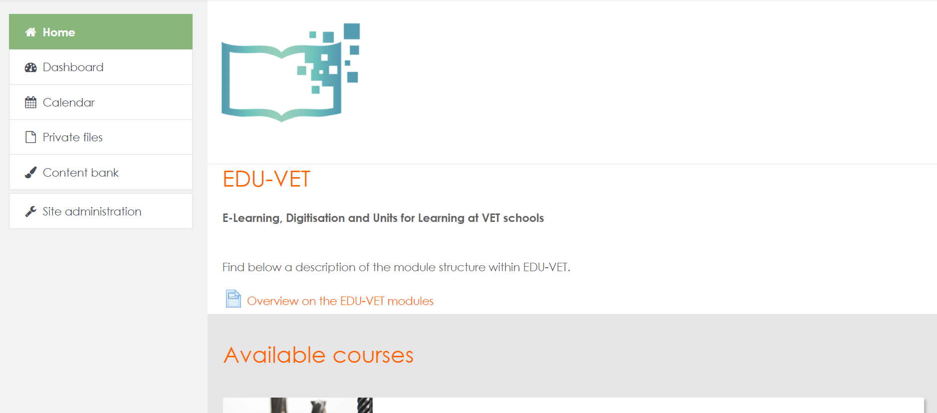
Current status of IO3 (UPB)
EDU-VET Learning platform – First insights
http://edu-vet.eduproject.eu/

Slide 6
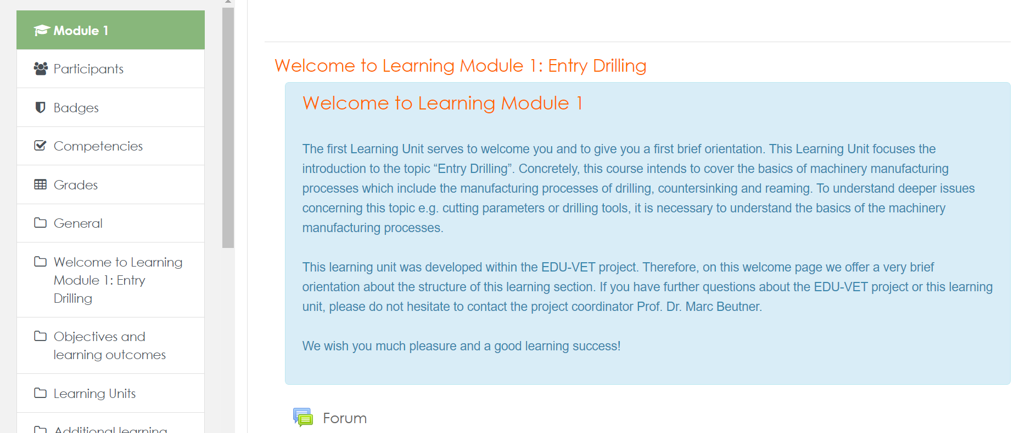
Current status of IO3 (UPB)
EDU-VET Learning platform – First insights

Slide 7
Current status of IO3 (UPB)
IO3: Online Courses for Technical education in metal industry
Creation of learning units (for online and classroom scenarios): In progress
Development of content design
Development of task design
Development of interactive tasks
Development of quizzes, questionnaires
Development of video and audio design etc.
Creation of Demo Course in Moodle: Done ✓
Creation of H5P and Moodle tasks: In progress
Creation of online tasks via H5P (testing phase; creation of the prototypes on H5P)
Creation of real tasks at Moodle (There will be an additional online meeting)

Slide 8
Current status of IO4 (UPB)
IO4: Handbook and Guidelines for teachers
Creation of structure and distribution of chapters: Done ✓
Writing of book chapters: In progress
Developing a framework regarding the guideline concept for teachers: In progress
Writing of guideline concept for teachers: In progress
Correction and Translation of handbook and guidelines: Starts soon

Slide 9
Current status of IO5 (UPB)
IO5: Showcases of best practice in eLearning at VET Schools
Creation of criteria setting for Online Observatory: Done ✓
Provide guidelines to partner: Done ✓
Translation of Business Profile in German language: Done ✓
Searching for best-practices (metal companies) which can be presented on Online Observatory: In progress

Slide 10
Current status – Dissemination activities (UPB)
Posts on EDU-VET Facebook: regularly
Posts on EDU-VET website: regularly
Posts on website of University: regularly
Writing of Online Article: In progress
Creation of 2nd Newsletter and 2nd flyer at the beginning of January 2021: Done ✓
Writing of Evaluation Report: Done ✓

Slide 11
Do you have any questions?
Contact
Marc Beutner University Paderborn, Warburger Str. 100 33098 Paderborn, Germany Marc.Beutner@uni-paderborn.de
http://wiwi.uni-paderborn.de/department5/ wirtschaftspaedagogik-prof-beutner/
The European Commission support for the production of this publication does not constitute an endorsement of the contents which reflects the views only of the authors, and the Commission cannot be held responsible for any use which may be made of the information contained therein.

